Slide 1
Growing Incredible Managers:
Managing your team
Prepared by
Greg Mathers, Certified Adizes Senior Associate
May-July 2019

Slide 2


Celeritas
Discuss Boyer’s PAEI code? Rate all 4 dimensions, (for example, you might see his strength as working with people and believe he has minimal abilities in A and P and no abilities in E and, therefore, rate him pa-I). Give supporting examples from the case.
What do you consider to be the 3 main problems facing this company.
In light of these problems, do you believe the team building event was the appropriate first step for solving these problems? Why or why not?
If you believe the team building event was the correct first step what would you do next? If you believe this was the wrong approach what would you suggest instead of the team building event as a first step?
©Adizes Institute 2019

Slide 3
Celeritas
Lack of trust and communication among senior executives
Inconsistent decision making and follow-through
Confusion about company goals and priorities
Poor coordination among business functions and units

Slide 4
Review:
What about change?
What about conflict?
What about styles?
What about management roles?

Slide 5
9 Characteristics of a Good Manager
Is well rounded (flexible in style)
Knows and accepts self
Is aware of effect on others
Knows how to slow down and relax
Can identify excellence in others
Can accept and appreciate differences in others
Can harness conflict
Creates a learning environment based on trust and respect
Aware of environment and changes
Mature well-rounded individual

Slide 6
Organizational Lifecycles
It is not the strongest of the species that survive, nor the most intelligent, but the one most responsive to change.
Charles Darwin
Growing
Aging
Problems
Fatal
Abnormal
Normal

Slide 7
Flexibility
Controllability
Predictability
Growing
Aging

Slide 8
Flexibility
Controllability
Death
Growing
Prime
Aging

Slide 9
The “organization” is an ‘idea’
Building Commitment
Founder(s) run the risk of losing control
Prophet or Profit?
Commitment < Risk → Affair
Courtship
Affair

Slide 10
The company is born when risk is taken
“We don’t need any more ideas, WE NEED RESULTS.”
Action oriented
Few policies, systems, procedures, budgets
Job description: everything
Limited delegation
Authoritarian Leadership
Infancy
Courtship
Affair

Slide 11
Loss of commitment
Vulnerability, a problem can become a crisis on short notice
Loss of cash
Loss of window of opportunity (timing)
Loss of founder
Loss of family support
Loss of “life”
Infancy
Infant Mortality
Courtship
Affair

Slide 12
Organization is Arrogant
Rapid Growth
Sales Oriented
Organized around people, not around tasks
Lack of Accountability
Opportunity driven
Too many priorities
Assumes →More revenue = More profits
Go-go
Infancy
Infant Mortality
Courtship
Affair

Slide 13
Crisis prompts the transition to the next stage on the lifecycle
Getting sued
Lose their shirts
Bad investments
Go-go
Infancy
Courtship

Slide 14
Needs:
Transition
Priorities
Systems & Accounting/Accountability
Order
Professional Management
SECOND BIRTH
Love Hate Relationship
Go-go

Slide 15
Needs:
Transition
From: Entrepreneurial Management
To: Professional Management
Go-go

Slide 16
Divorce
The Risk averse squeezes out the entrepreneurial partners or management
Premature Aging
Divorce
Adolescence
Unfulfilled Entrepreneur
Go-go
Founders Trap
The Revolving Door Entrepreneur / Founder unwilling or unable to make the necessary adolescence adaptations fires the professional managers and administrators….AGAIN
Infant Mortality
Infancy
Courtship
Affair

Slide 17
Needs:
Transition
From: More is Better
To: Better is More
New Definition of the Company
Change of Organization Structure
Change of Incentive Systems
Change Accountability and Information System
Leadership Transition
Go-go

Slide 18
“Us” versus “Them” mentality
Internal conflicts
Inconsistency in goals and in compensation systems
Temporary loss of Vision
Policies made but not adhered to
Major Transitions: Delegation of Authority, Change in Leadership, and Goals Displacement
Entrepreneurship feels threatened by Administration
Yo-Yo: “You’re in charge. No, I’m in charge”
Adolescence
Go-go
Infant Mortality
Infancy
Courtship
Affair

Slide 19
If an effective transition to Adolescence is not made…
the organization falls into Founder’s/Family Trap
Go-go
Founders Trap
Organization ages and dies when the Founder ages
Infant Mortality
Infancy
Courtship
Affair

Slide 20
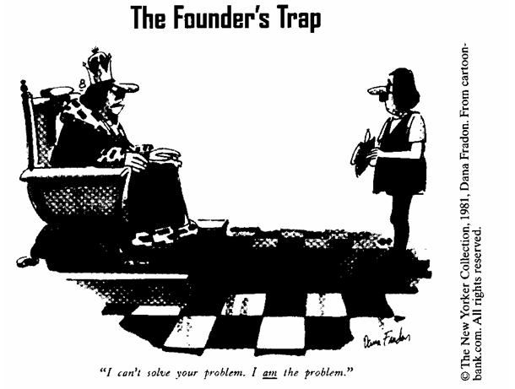

Slide 21
The “Optimum” Region
Prime
Divorce
Unfulfilled Entrepreneur
Balanced self-control, & flexibility
Functional organization structure
Insufficient managerial depth
Can increase sales AND profits simultaneously
Creates new infant organizations
Reorganizes and Emancipates as needed
Adolescence
Premature Aging
Go-go
Founders Trap
Infant Mortality
Infancy
Courtship
Affair

Slide 22
Stable
1
2

Slide 23
Growing Companies
Aging Companies
Personal success stems from taking risk
Expectations exceed results
The organization is in cash poor
The organization emphasizes function over form
People focus on why and what to do
People are kept for their contributions despite their personalities
Everything is permitted, unless expressly forbidden
Problems are seen as opportunities
The marketing and sales departments have political power
People on the line call the shots
Responsibility is not matched with authority
Management drives the organization
Management drives the momentum
Change in leadership can lead to change in organizational behavior
The organization needs consultants
The organization exists to create value
Personal success stems from avoiding risk
Results exceed expectations
The organization is in cash rich
The organization emphasizes form over function
People focus on how and who did it
People are kept for their personalities despite their lack of contributions
Everything is forbidden, unless expressly permitted
Opportunities are seen as problems
The accounting, finance and legal departments have political power
Corporate staff calls the shots
Authority is not matched with responsibility
The organization drives management
Management rides the inertia
To change organizational behavior, it’s necessary to change the system
The organization needs “insultants”
The organization is profit-obsessed

Slide 24
Stable
Aristocracy
Cultural Change
Meeting Formality
Dress code, address and tradition
“Don’t make waves”
Enamored with the past, paralyzed to deal with the future
Cash rich & Financial Statements look good
Externalizes the problem, wishes the external environment would become favorable
Buys new products, ideas or companies versus “self’ innovation

Slide 25
Stable
Aristocracy
Witch Hunt
Early Bureaucracy
Emphasis on Who caused the problem rather than on solving the problem - as if solving the “who” solves the “what”
Conflict & paranoia (backstabbing and infighting)
Focus on internal turf wars, where the external customer becomes a nuisance
Internal conflicts hampers alignment to markets

Slide 26
Stable
Aristocracy
Early Bureaucracy
Many systems but little functional orientation
Internal Focus
“It’s the policy”... without having a functional explanation for it
Lots of policies, but no “real” control
Customers have difficulty being heard or served and need bypass systems to deal with the Bureaucracy
Bureaucracy

Slide 27
Stable
Aristocracy
Early Bureaucracy
No one committed
Death may take years
Unwilling to eliminate jobs (government agencies, union pressures)
Very expensive artificial prolonging of life
“If - only” mentality
Bureaucracy
Death

Slide 28
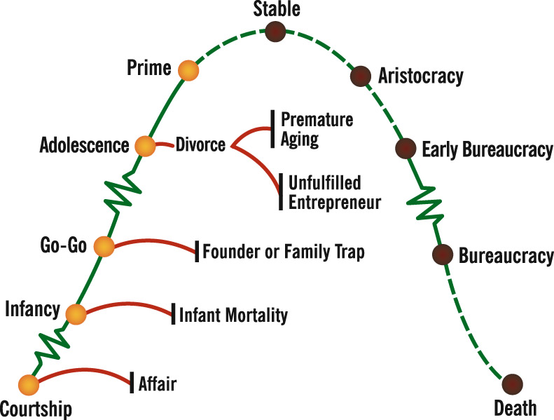
Lifecycle of an Organization

Slide 29
Lifecycle of an Organization
PAEI
PAEI
PA _ I
PAEI
PA _ _
_ A _ I
PAEI
P _ E _
_ A _ _
PAEI
P_ _ _
PAEI
_ _E_
_ _ _ _

Slide 30
Lifecycle of an Organization
PROTECT
THE GAINS
SALES &
PROFITS
ROI
PROFITS
PERSONAL SURVIVAL
SALES &
MARKETSHARE
EXTERNAL &
INTERNAL
POLITICS
CASH
RESPOND
TO NEEDS
MIRACLES

Slide 31
Thank You!
Next week article
http://www.fastcompany.com/41088/i-can-only-compete-through-my-crew

